Slide 1
Fast LTL pathfinding in partially known environments
By: Aryan Gupta

Slide 2
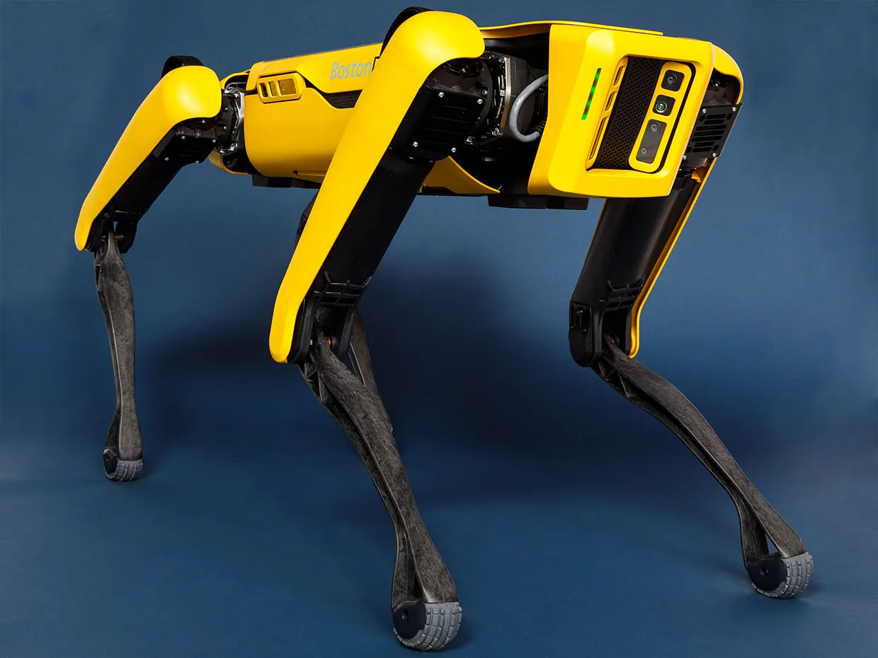
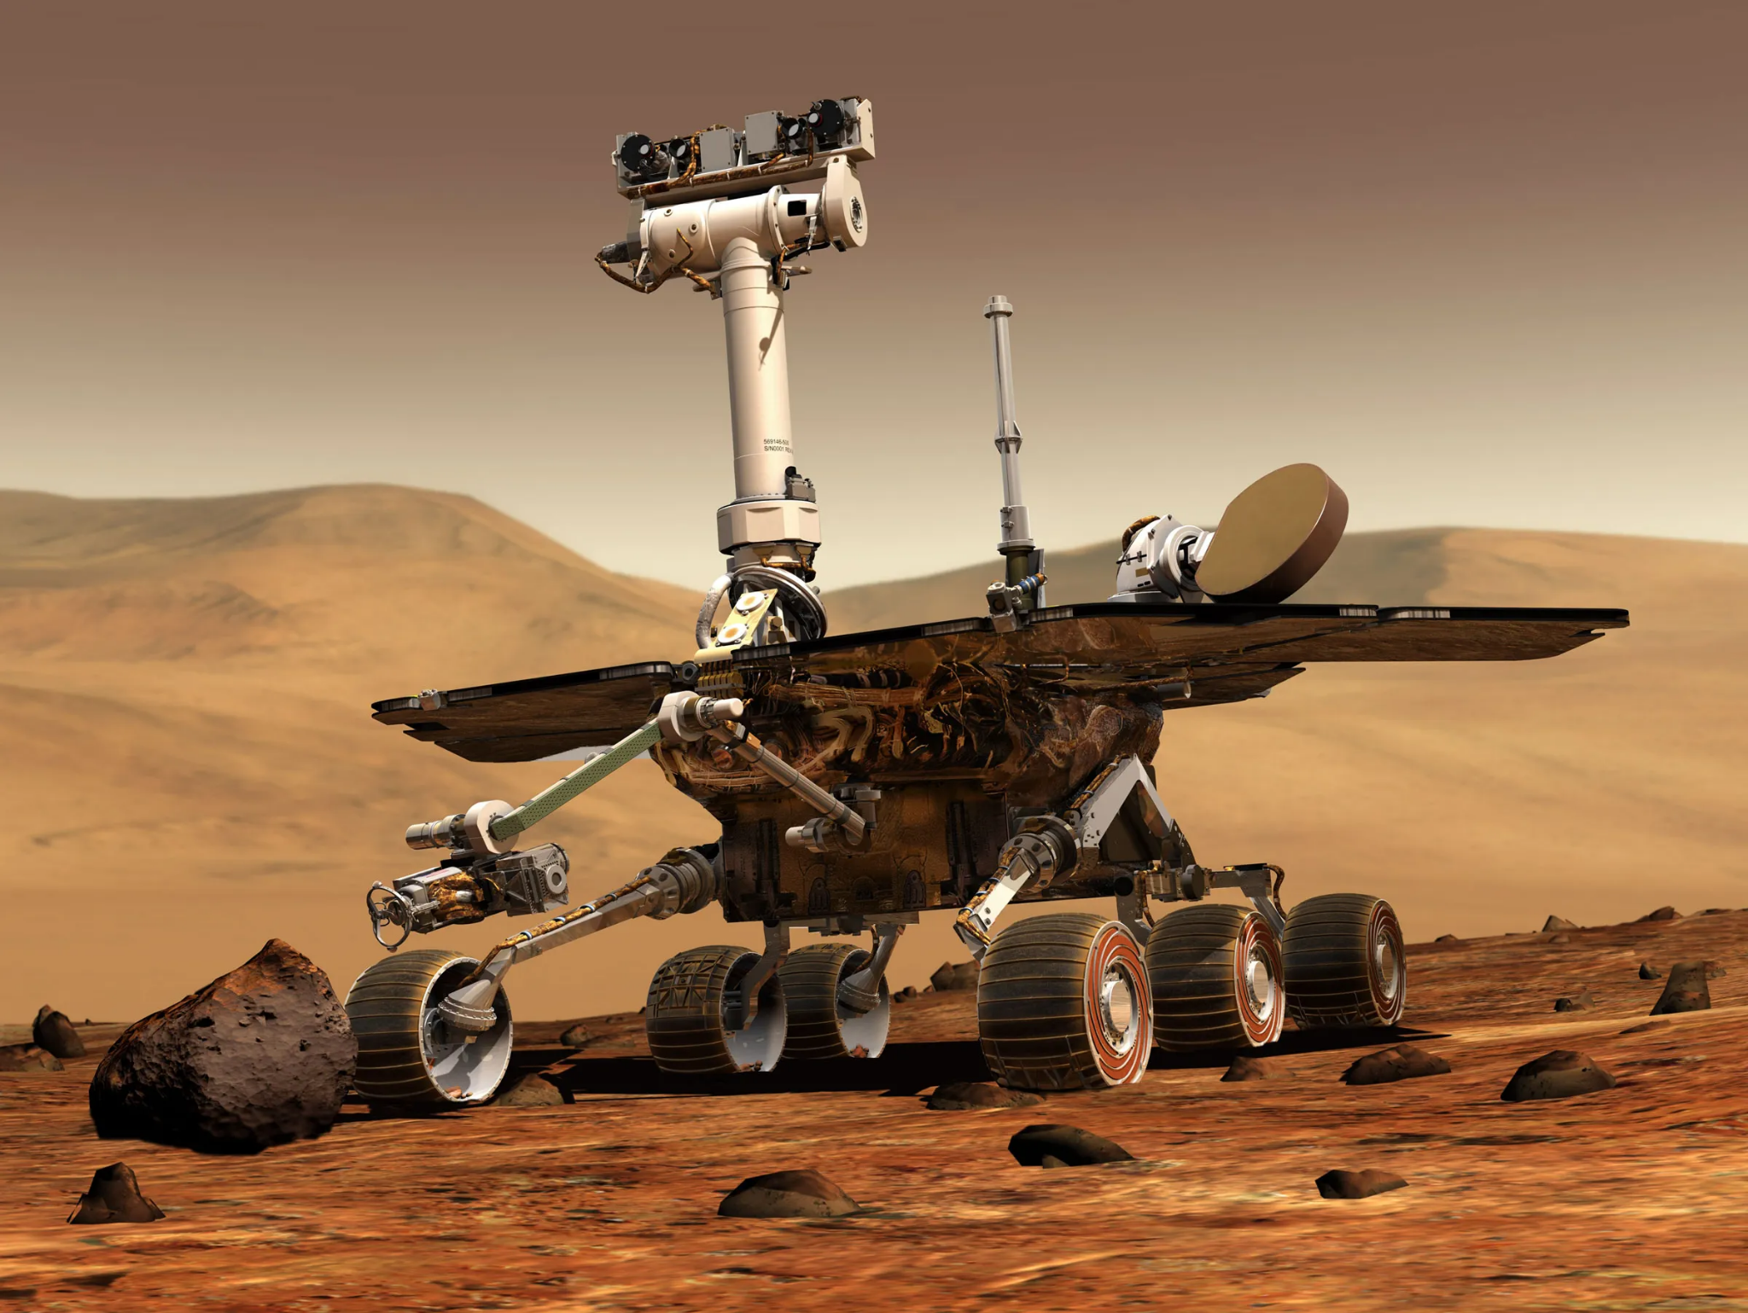
Purpose
Defense Sector
Tasked Agent
Risky Combat Zones
Space Sector
Detect and avoid risk
Satellite imagery

Slide 3
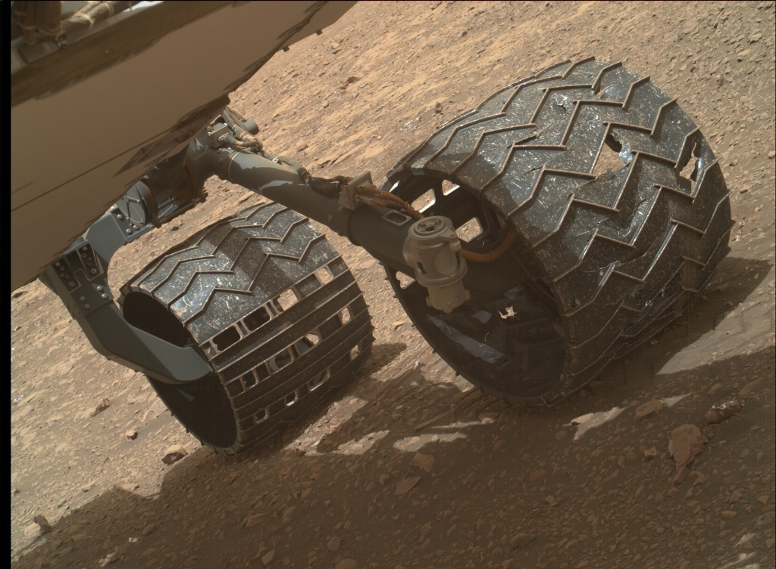
Abstract
Agent
Must complete task
Must not crash
Risky Environment

Slide 4
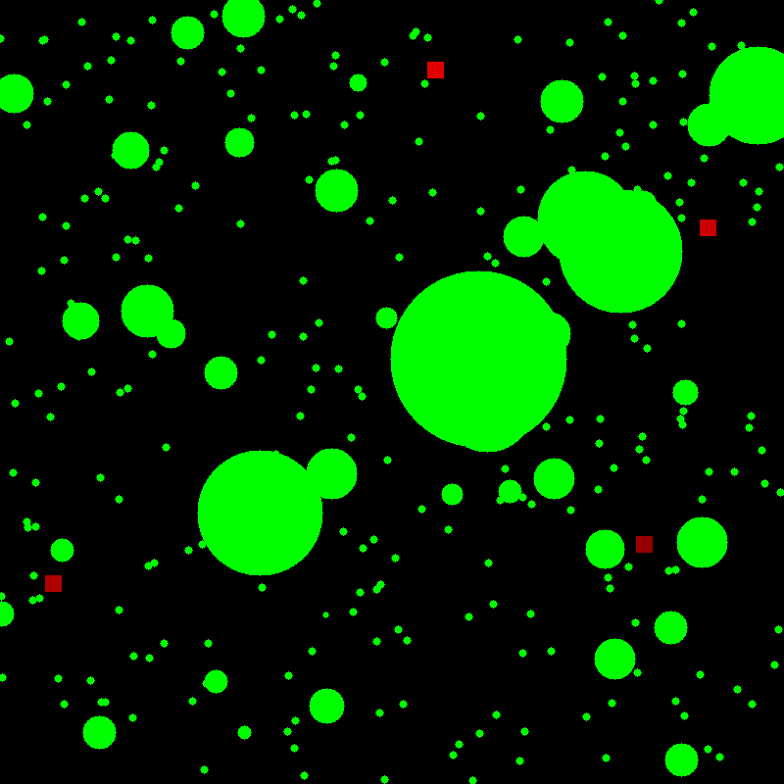
Environment
Risky objects (green)
Warhead craters
Debris
LTL targets
Pickup areas
Temporary bases
Downed personnel
Downed tanks
Drilling sites

Slide 5
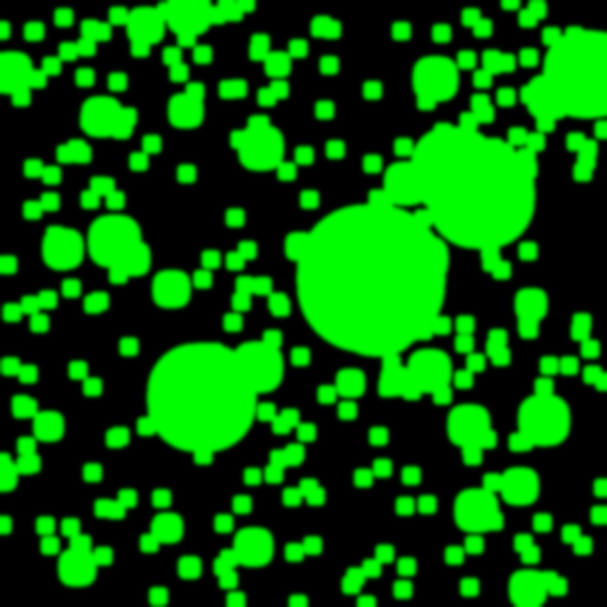
Satellite Imagery
In the real world, satellite imagery isn’t at the best resolution
Risk must be assumed surrounding objects
Objects may have been moved by environment, other agents, or antagonists

Slide 6

Satellite Imagery

Slide 7
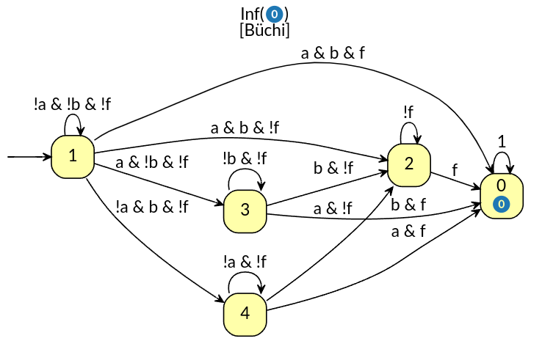
Task - Linear Temporal Logic
Ff & (!f U a) & (!f U b)
f, a, b are axioms
Can represent
A physical location
A intrinsic value
A extrinsic value

Slide 8
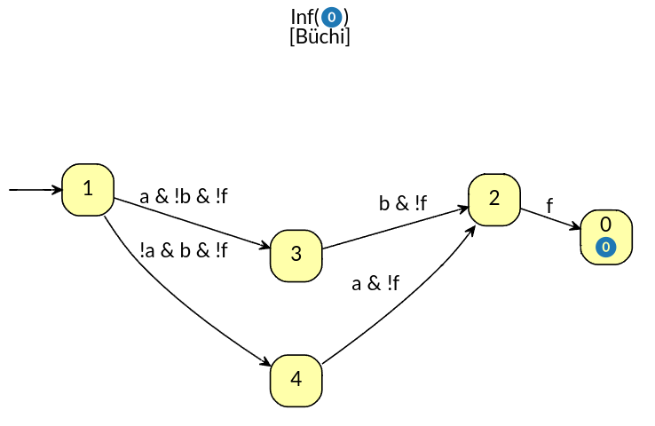
LTL pathfinding
Ff & (!f U a) & (!f U b)
Heuristic Function
Distance to accepting state
Multiple transition axioms are ignored in the slides for brevity
Better h-functions exist, which will be discussed later as its not programmatically finished
3
1
0
2
2

Slide 9
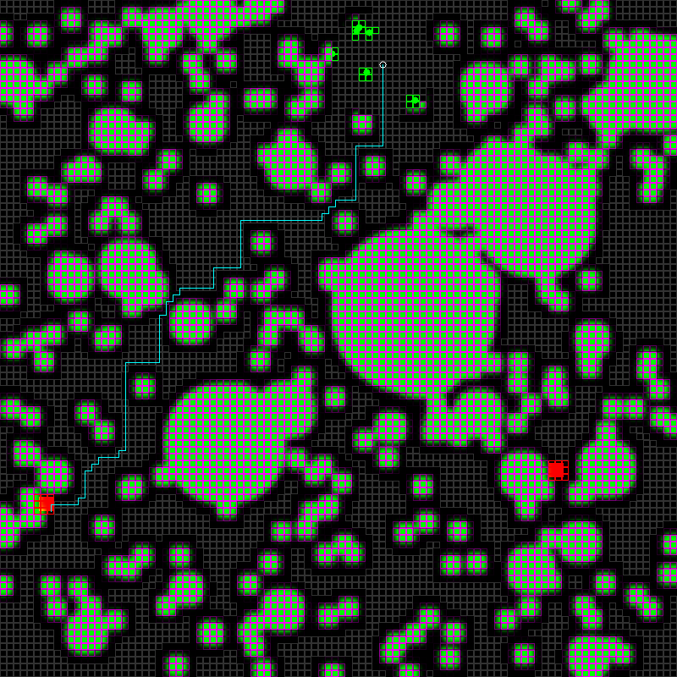
Pathfinding
a and b sites are possible
Both sites have equal LTL hfunc weight
Algo will choose one with shortest and least risky phys path
WIP: max cumulative risk
WIP: max absolute risk

Slide 10
Pathfinding
Ff & (!f U a) & (!f U b)
0
ab + bf
a
ba + af
b

Slide 11

Pathfinding
Dynamic Risk
Partial A* (WIP)

Slide 12
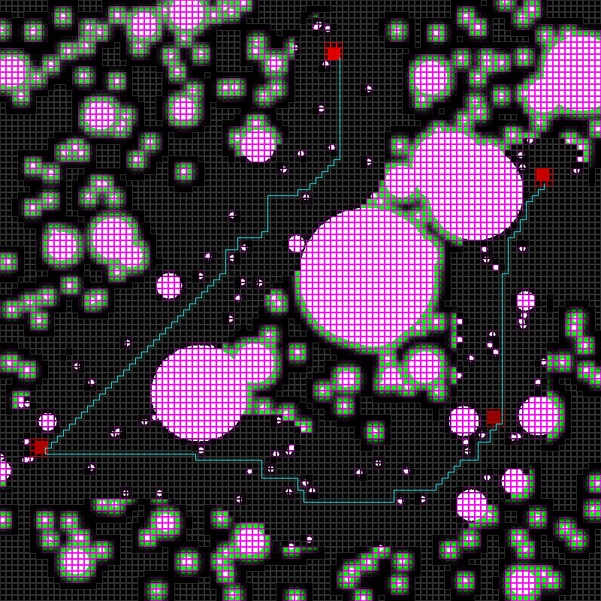
Pathfinding

Slide 13
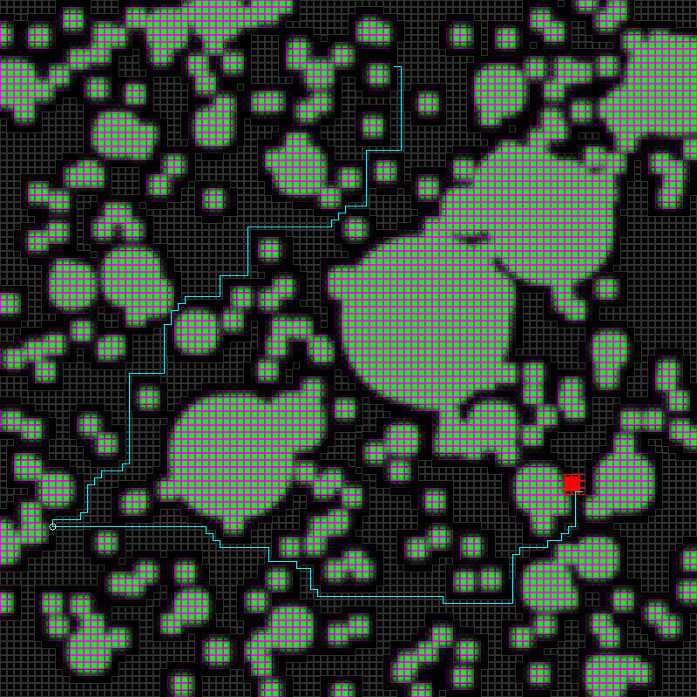
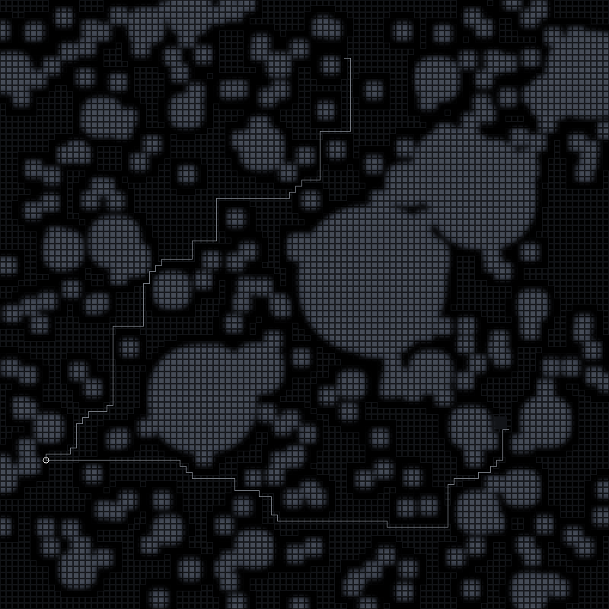
Pathfinding
no risk updates
full astar
len: 104

Slide 14
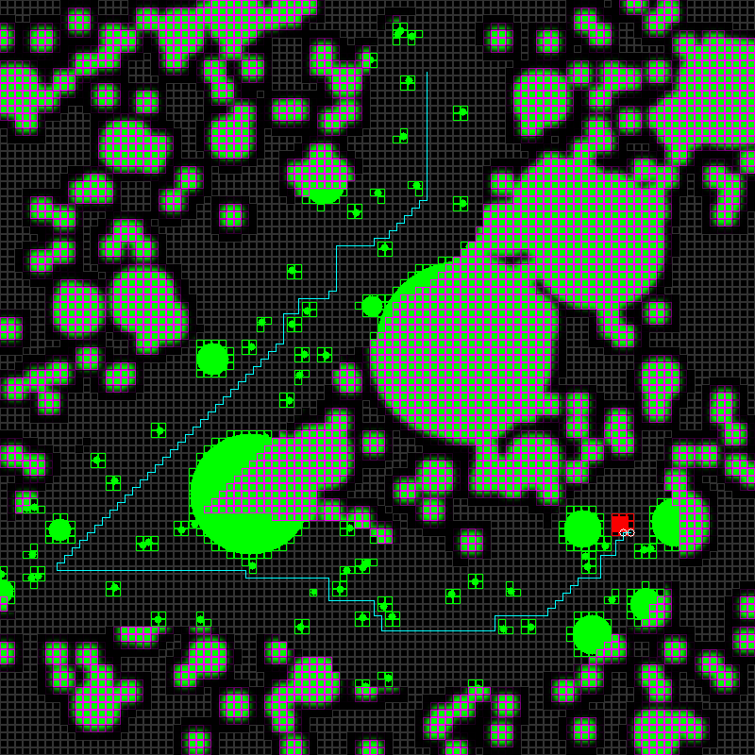
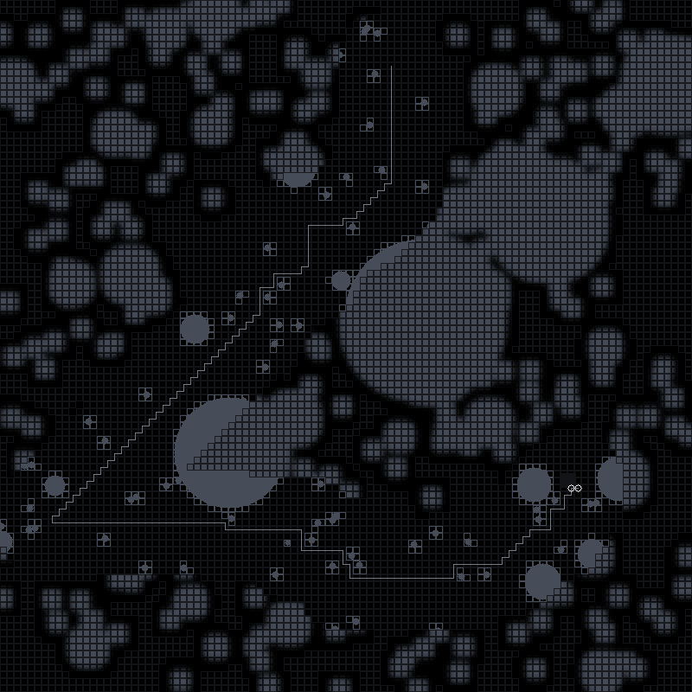
Pathfinding
with risk updates
partial astar
len: 98

Slide 15
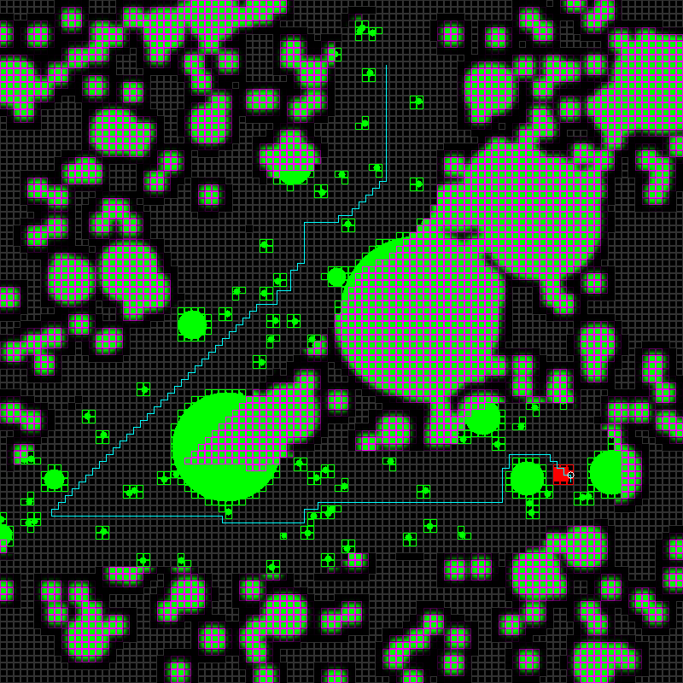
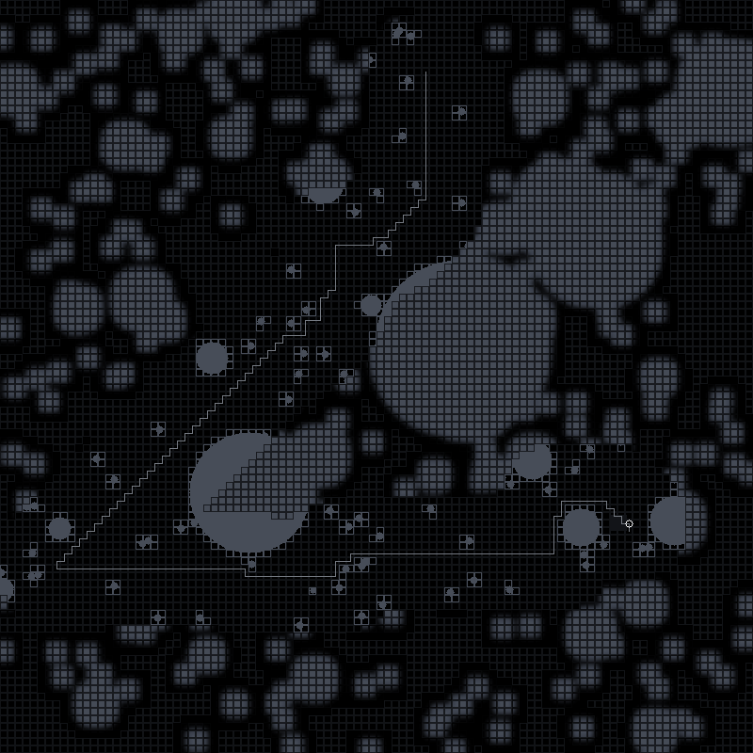
Pathfinding
with risk updates
full astar
len: 90
98

Slide 16
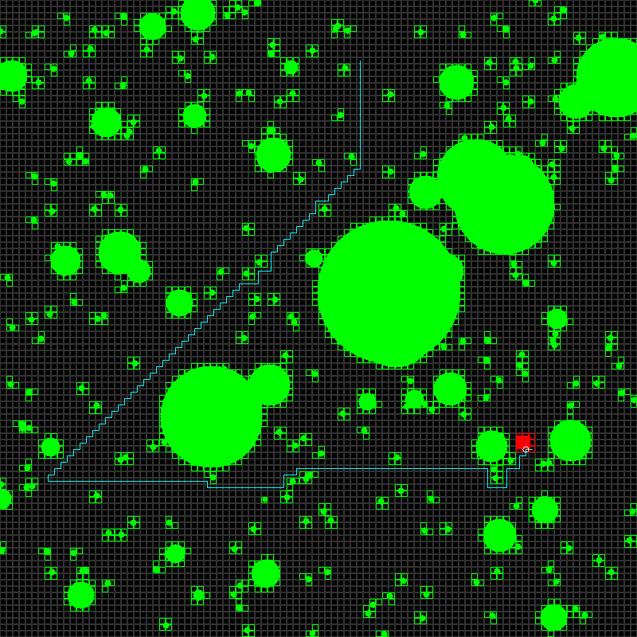
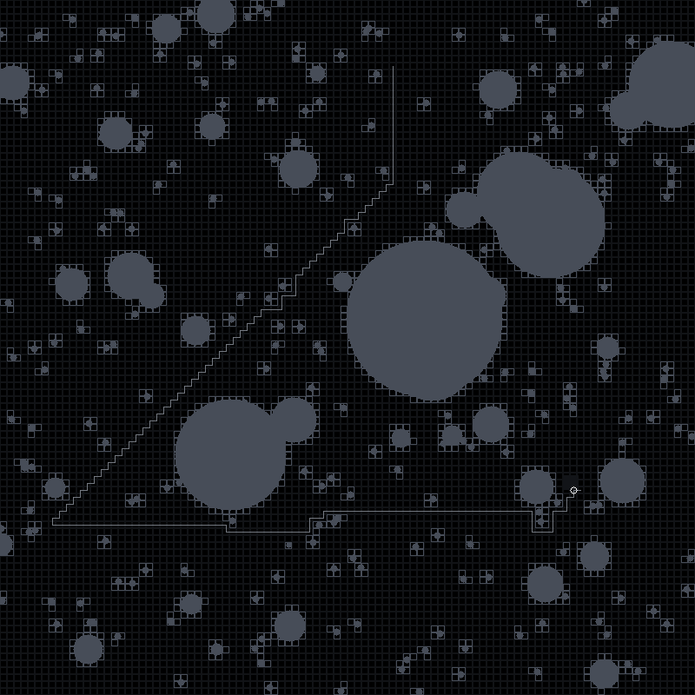
Pathfinding
no risk
full astar
len: 90

Slide 17
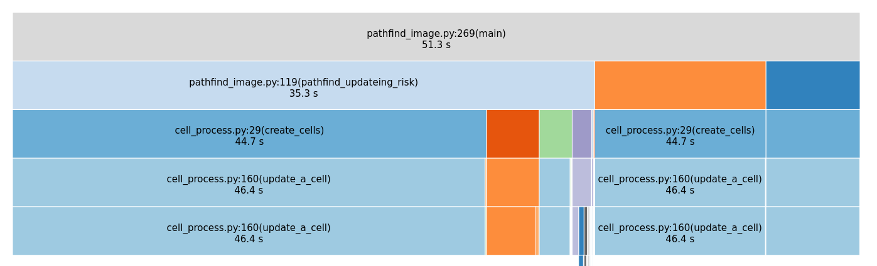
Timing
Timings on image are correct but misleading
Entire Script - 51.7s
Final Image Creation (debugging) - 10.4s
Algo - 41.3s
Pre-processing - 35.8s
Updating risk - 5.1s
Astar - 1.2s

Slide 18
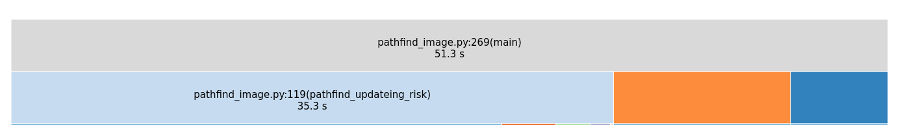
Timing
10.4s
5.71s
Pathfinder algorithm
Create Final Path Image
Find LTL targets

Slide 19
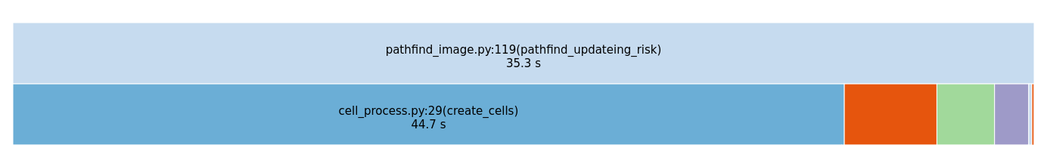
Timing
Extract Cells From Satellite Image

Slide 20

Timing
Update Viewed Surrounding Risk
(3.2s)
Update New Viewed Cells
(2s)
astar
(1.3s)

Slide 21
Questions?
Constructive Criticism?

